Slide 1
Small Church Big Mission
Developing a Missional Culture

Slide 2
Accountability
Membership assumes accountability before God and toward one another. Accountability has an inward and an outward dimension, with a biblical commission supporting both aspects.
Looking inward, the church is commissioned to be a“binding and loosing”fellowship.The joyful obligation of membership includes the calling to build up the body of Christ through mutual discernment of the will of God.
Looking outward, the church is commissioned to“make disciples of all nations.” Membership includes the invitation to become a community engaged in mission and service.
Mennonite Church USA Membership Guidelines, 2001

Slide 3
Healthy Congregations
Healthy Congregations have a clear and shared center
Healthy Congregations have clear and permeable membranes
Healthy Congregations focus outward not just inward.

Slide 4
Vision: Who we aspire to BE
Mission: What we aspire to DO

Slide 5
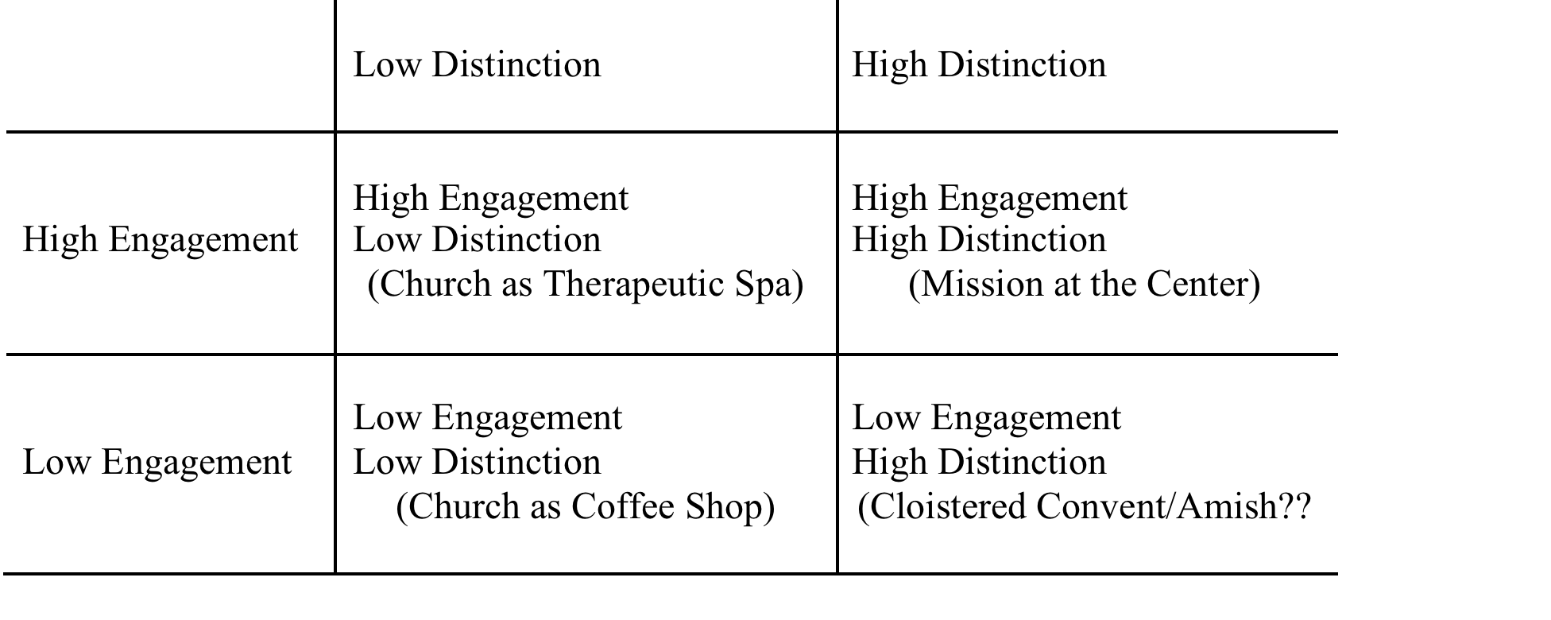
Mission at the Center: Distinctive and Engaged

Slide 6
Vision: Healing and Hope
God calls us to be followers of Jesus Christ, and by the power of the Holy Spirit, to grow as communities of grace, joy and peace, so that God’s healing and hope flow through us to the world.

Slide 7
Clarifying Mission
Core Values
Mission Statement
Expected Outcomes
Strategies
Evaluation

Slide 8
Core Values
We value the spiritual development of children and adults through Christ-centered programs.
We value excellent facilities.
We want to be a camp of regional distinction.
We want to extend generous hospitality.
We value God’s creation.
We value administrative and fiscal sustainability.
Mission Statement
Crooked Creek Christian Camp serves the spiritual development of children and adults in the Midwest by providing Christ-centered programs, excellent facilities, and generous hospitality in a setting that celebrates God’s creation. (values underlined)

Slide 9
Core Values/Expected Outcomes for Holistic Witness
Leadership for Witness: Central Plains Mennonite Conference calls and equips pastors and congregational leaders with missional vision and leadership skills for the church.
Fellowship as Witness: Central Plains Mennonite congregations develop loving relationships with one another, as well as with Christians across the church and around the world, to discern a common way of life as a contrast society.
Discipleship For Witness: The members of Central Plains Mennonite Conference seek to grow continually in Christ-likeness in order to embody a holistic witness to the life, death and resurrection of Jesus.

Slide 10
Mission Statement
The mission of Central Plains Mennonite Conference is to create settings for our congregations and partners to grow in holistic witness to God’s reconciling mission in the world by developing leadership, encouraging fellowship, and promoting lifelong discipleship

Slide 11
Priorities Aligned with Purposeful Plan
Mennonite Church USA Priorities
Central Plains Priorities
Holistic Witness
Christian Community
Christian Formation
Leadership Development
Undoing Racism/Intercultural Transformation
Church-to-Church Relationships
Stewardship
Focus of all Priorities
Fellowship
Discipleship
Leadership
Fellowship
Fellowship
Discipleship

Slide 12
Missional Questions for Strategic Planning
What is God’s preferred future for our congregation?
In our context, what are the places where sin, brokenness, and alienation wait in hope of redemption?
What resources has God given our congregations to realize God’s preferred future?
What are the resources that are needed to realize God’s preferred future for our congregation?

Slide 13
Modified SWOT Process
At Kingdom Mennonite Church, we care most about… (Strengths)
At Kingdom Mennonite Church we are most concerned about… (Weaknesses/Threats)
At Kingdom Mennonite Church our highest hopes and dreams are...(Opportunities)

Slide 14
PRES Statement Discernment
Define the question in focus
Frame the question in focus: Regarding (the question in focus) what is God’s preferred future for our congregation?
After a time of silent reflection, get into groups of no more than seven and have each member offer a PRES Statement:
Position
Reason
Example
Summary
Build Consensus on shared statements (3, 2, 1)

