Slide 1
Revitalizing Mennonite Congregations
Responding to challenges with purpose and intention

Slide 2
Where we’re going
Introduction
What brings us to this place?
The world has changed
Considering our DNA
Systemic changes that support your missional purpose

Slide 3
Centering our time together
Ephesians 2:11 - 11

Slide 4
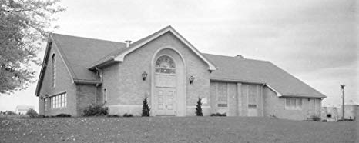
Metamora Mennonite Church

Slide 5
Pastor, you’re the expert…fix it!
“In times of distress, we turn to authority. To the breaking point, we place our hopes and frustrations upon those whose presumed knowledge, wisdom and skill show promise of fulfillment.”
Ron Heifetz, Leadership Without Easy Answers

Slide 6
Discussion Questions
What brings you into this space this morning?
What is the primary challenge facing your congregation?

Slide 7
The world has changed
“In the 1940’s and 1950’s it was still possible to think of western Europe and North America as a ‘Christendom,’ in the sense that there were close links between religious and secular elites, that most children were socialized into membership in a Christian society, and that the church had a large presence in fields such as education and welfare, and a major influence on law and morality.”
Hugh McLeod, The Religious Crises of the 1960s

Slide 8
The world has changed
“In the religious history of the West these years may come to be seen as marking a rupture as profound as that brought about by the Reformation…The 1960’s was an international phenomenon.”
Hugh McLeod, The Religious Crises of the 1960s

Slide 9
The world has changed
This Photo by Unknown Author is licensed under CC BY-SA-NC

Slide 10
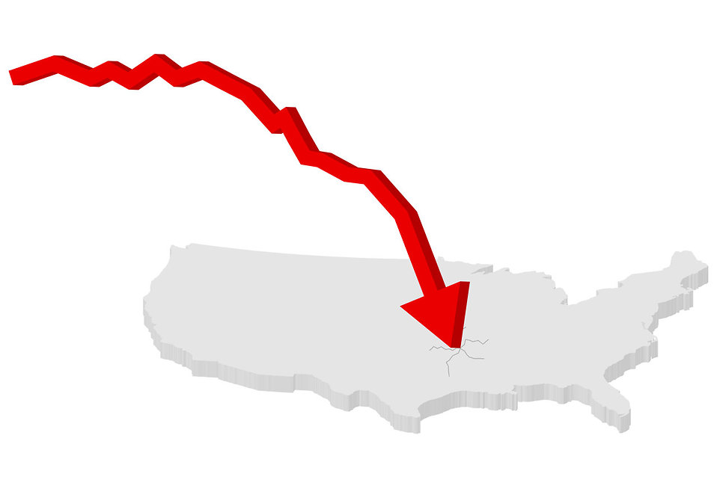
The world has changed
This Photo by Unknown Author is licensed under CC BY-SA-NC

Slide 11
The world has changed
Two Types of Challenges
Technical – a challenge we already know how to respond to, all we need to do is execute what we already know.
Adaptive – a challenge where no adequate response has been developed.

Slide 12
Framing Leadership
Approaching adaptive challenges as if they are technical challenges leads to frustration by communities and leaders alike.

Slide 13
Discussion question
Think about the challenge you identified: Is it an adaptive challenge or a technical challenge?

Slide 14
When facing adaptive challenges, it is important to resist being a fixer!

Slide 15
Discussion question
Think about the challenge you identified: How are you responding?

Slide 16
Asking different questions
One way to lead in adaptive spaces is to ask different questions.

Slide 17
Asking different questions
“There is depth in the question ‘How do I do this?’ that is worth exploring. The question is a defense against the action. It is a leap past the question of purpose, past the question of intentions, and past the drama of responsibility. The question ‘How?’ – more than any other question – looks for answers outside of us. It is an indirect expression of our doubts.” Peter Block, Stewardship

Slide 18
Asking different questions
Start with questions of
Purpose – why are we here
Intentions – what are we trying to do
Responsibility – what is my responsibility?

Slide 19
Asking different questions
“We often avoid the question of whether or not something is worth doing by going straight to the question, ‘How do we do it?’ In fact, when we believe that something is definitely not worth doing, we are particularly eager to start asking ‘How?’ Peter Block, The Answer to How is Yes

Slide 20
Asking Different Questions
How Questions
How do you do it?
How long will it take?
How much does it cost?
How do you get those people to change?
How do we measure it?
How are other people doing it successfully?

Slide 21
Asking Different Questions
How Questions
Alternate Questions
How do you do it?
How long will it take?
How much does it cost?
How do you get those people to change?
How do we measure it?
How are other people doing it successfully?
What refusal have I been postponing?
What commitment am I willing to make?
What price am I willing to pay?
What is my contribution to the problem I’m concerned with?
What is the crossroads at which I find myself at this point in life/work?
What do we want to create together?

Slide 22
Considering our DNA
In what ways, if any, does being Mennonite impact invitation, welcome and inclusion of non-Mennonite others in the life of the church?

Slide 23
Considering our DNA
Question 1:
How do Mennonites relate to non-Mennonites in the community?

Slide 24
Considering our DNA
Question 2:
How do cradle and creedal Mennonites relate in the church?

Slide 25
Considering our DNA
Question 3:
How do Anabaptist theological commitments impact how Mennonites engage non-Mennonites?

Slide 26
Considering our DNA
Question 4:
How are Anabaptist theological commitments practiced?

Slide 27
Considering our DNA
Questions, questions, and more questions!!!

Slide 28
Considering our DNA
Four Observations

Slide 29
Discussion Questions
How do your Mennonite identity and core beliefs connect with your purpose?
How do you intentionally create a path of relational belonging for newcomers in your church?
How do you intentionally form people into Anabaptist followers of Jesus?
Who is responsible?

Slide 30
Systemic changes
Given our purpose, intention, and responsibility, what do we do now?

Slide 31
5 Practices
Listening

Slide 32
5 Practices
Listening
Discerning

Slide 33
5 Practices
Listening
Discerning
Testing Experimenting

Slide 34
5 Practices
Listening
Discerning
Testing Experimenting
Reflection

Slide 35
5 Practices
Listening
Discerning
Testing Experimenting
Reflection
Deciding

Slide 36
5 Practices
This is ONE process! (Don’t skip practices 4 and 5)
Get into the rhythm of these practices
They are helpful to every ministry/leadership team.
They provide a different starting point than “what we’ve done before”

Slide 37
Discussion Questions
Listening: Describe your neighborhood and the people you meet there?
Discerning: What is God up to in your neighborhood? How might the Spirit be inviting you to join what God is doing there?
Experiment: Brainstorm a ministry experiment that is simple, easy to do, and requires you to enter the neighborhood…

